Slide 1
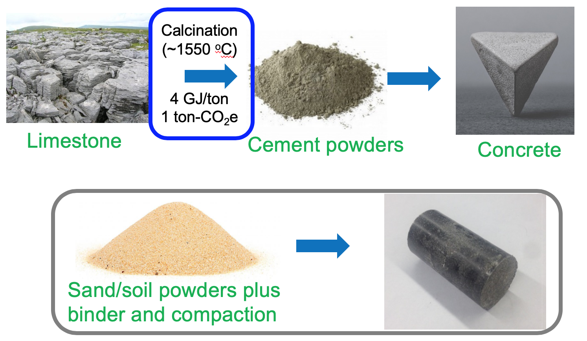
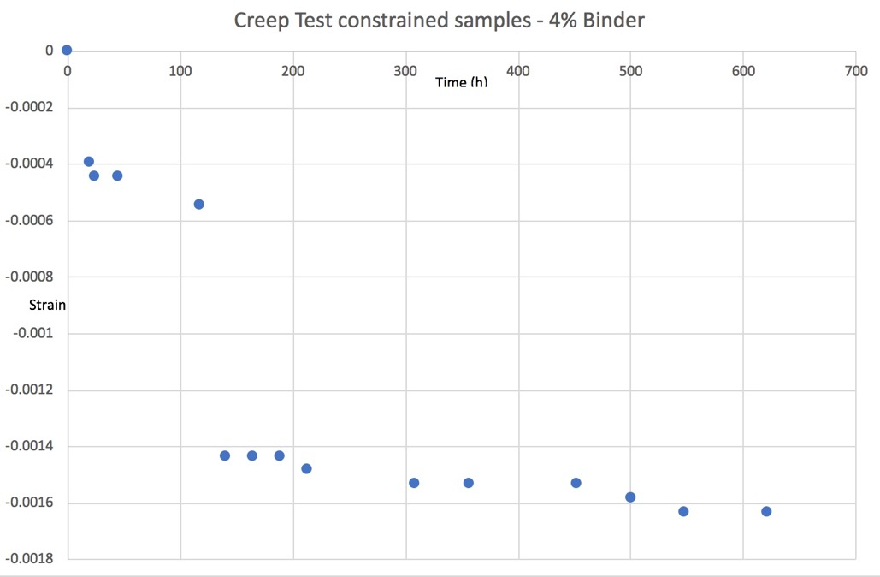
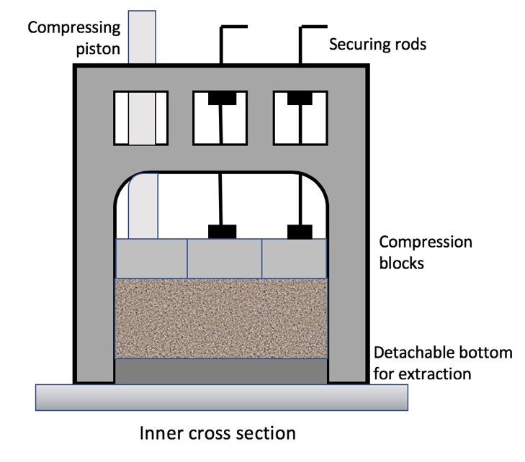
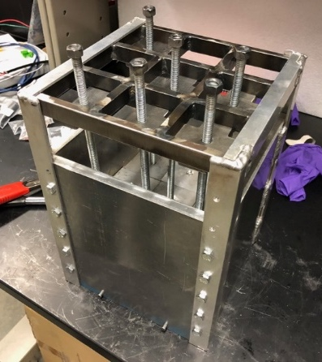
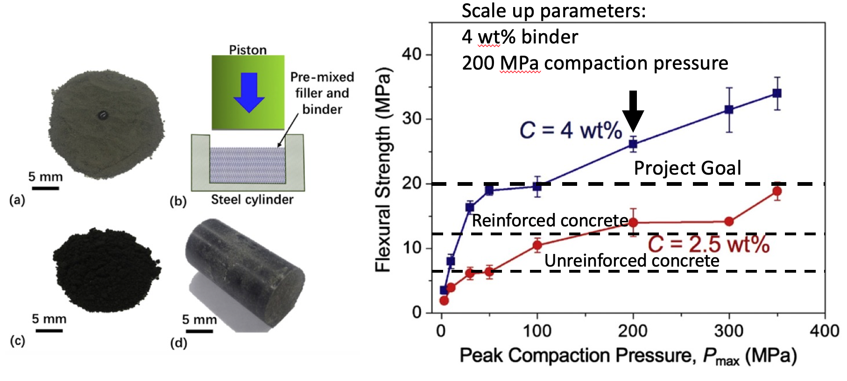
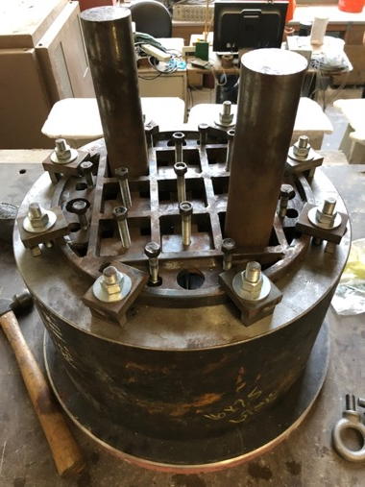
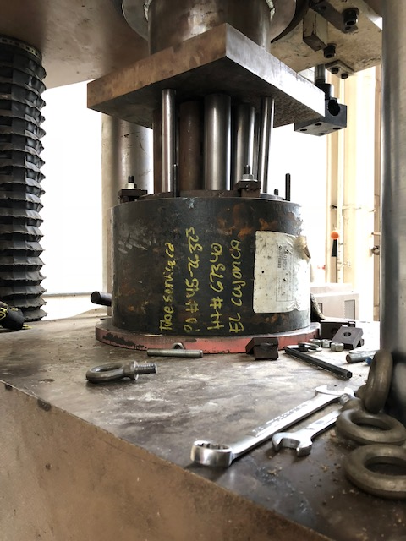
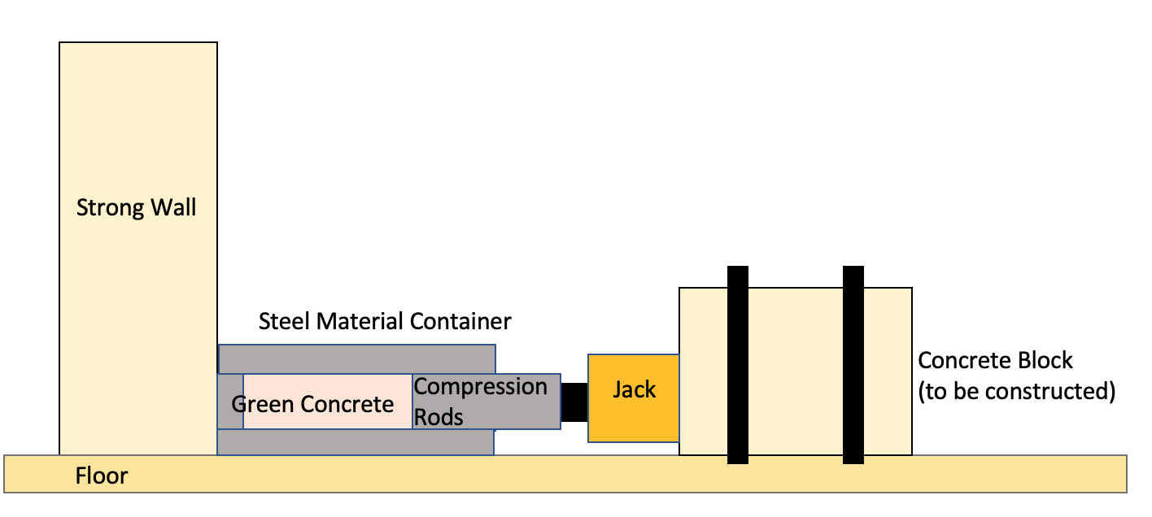
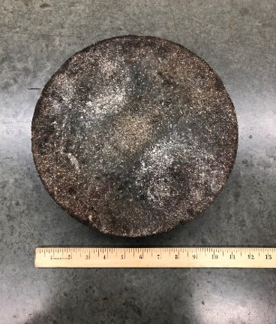
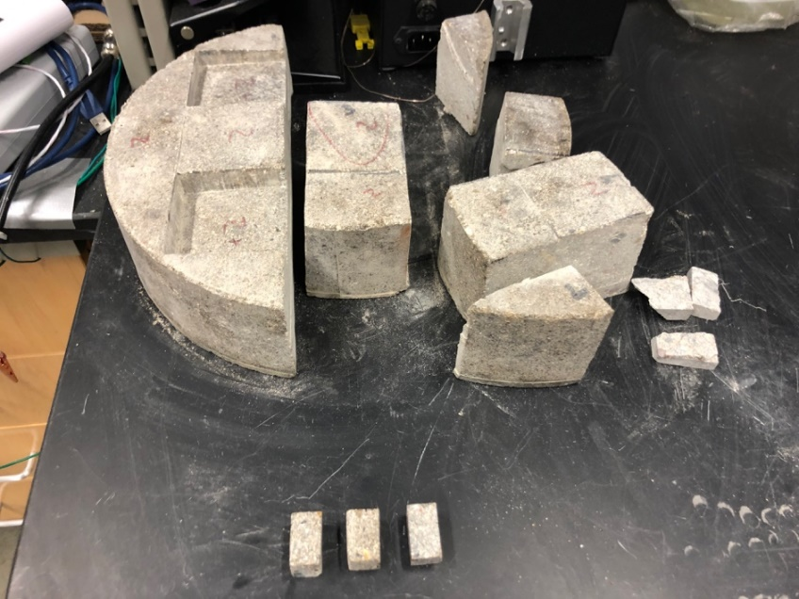
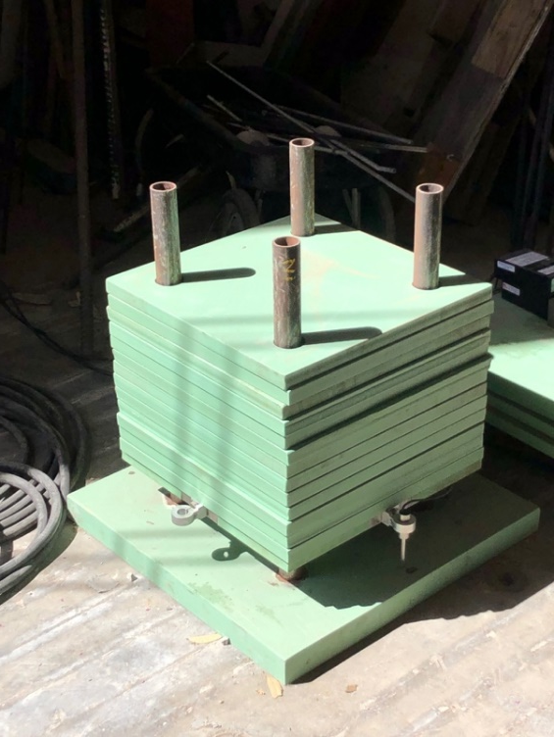
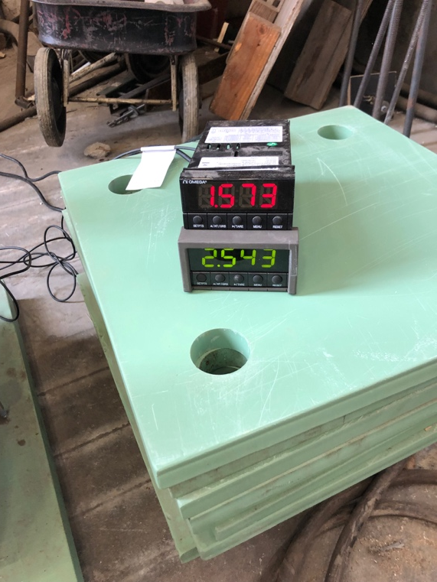

Advanced Manufacturing of Ultralow-Binder Composite and Its Application for ‘Green’ Concrete Structures
Albert Gasser, UC San Diego
Carbon Neutrality Initiative Fellowship
Introduction
Project Goals
Results and Outcomes
Why ‘Green’ Concrete?
Most manufactured goods have some carbon footprint originating from electricity or heat used in production
Portland cement (binder for concrete) is unique in that CO2 is a byproduct of the raw materials
  CaCO₃ → CaO + CO₂(g) - Calcination of limestone
    Account for about ~60% of emissions from production
  CO₂ output as much as 1:1 by weight to cement
  Contributes about 10% of worldwide CO₂ emissions ¹
Output estimated at around 4 Gt/yr
Huge market – niche applications can be targeted first
Portland Cement vs. Our Approach
Potential for ultra-low binder content
Binder content must be low (<5%) in order to be cost competitive with Portland concrete
High pressure consolidation step yields strength comparable or greater than reinforced steel ²
Self-Assembly of Polymer Micro-Agglomeration (PMA) Network
Completed in the “one-step” high-pressure compaction
Starting from breakdown of binder droplets in interstitial sites
Followed by surface flow driven by the large capillary force at the narrowest places (direct contact points of filler particles)
Breakdown of binder droplets in interstitial sites
Formation of polymer micro-agglomerations (PMA) at the direct contact points
Develop system to scale up from lab scale (~5g) to the scale of structural members (~500 lbs)
Phase 1 – develop system for 20lb concrete parts
Phase 2 – develop system for 500lb concrete parts
Test strength and creep of concrete parts
Challenges of Scaling Up
Limitations of compaction force
Constraining material in sections where force is not applied
Pot life of thermoset resin
Extraction from mold
Curing
Compressive and flexural strengths were measured. The flexural strength was consistently higher than the project goal (2000 psi). The compressive strength distributed in the range from ~7,000 psi to ~10,000 psi, more than or close to the project goal (8700 psi), much higher than the compressive strength of ordinary Portland cement (OPC) based concrete (3000~4000 psi).
The creep testing was carried out with loading at 25% of compressive strength for 1 month. Creep test data shows the creep strain to be consistently less than initial project goal of 0.004. A typical creep profile shown below.
Materials and Methods
20 lb System Development
Initial Design
Based on 200 MPa consolidation pressure
Satec (hydraulic structural testing machine) max force of 600 kip (2669 kN) – key limitation
Compression blocks sized 2.5”x2.5” so that full consolidation pressure can be reached
Other blocks constrained by vertical rods above
The first iteration failed, a more robust design developed
Design was successful in the ability to reach a peak compaction pressure of 200 MPa. However, setup was quite bulky, and process take up to 4 hours to complete.
Finished 20lb green concrete sample and 20lb sample cut to test smaller specimens
Creep test setup developed for this project to measure deformation by compression over time
Future Goals
Finish 500lb system development
A different approach had to be taken for 500lb concrete parts because of limitations of Satec machine. The new design will use hydraulic jack compressing horizontally.
Literature Cited
Scrivener, Karen L.; John, Vanderley M.; Gartner, Ellis M. (June 2018). "Eco-efficient cements: Potential economically viable solutions for a low-CO 2 cement-based materials industry". Cement and Concrete Research.
Chen T, Chow BJ, Zhong Y, Wang M, Kou R, Qiao Y. Formation of polymer micro-agglomerations in ultralow-binder-content composite based on lunar soil simulant. Adv Space Res 2018;61:830–6.
Acknowledgements
University of California
UC Carbon Neutrality Initiative
Dr. Yu Qiao
Kiwon Oh
Notes:
Phase II: In-depth assessment (similar to LEEDS) and information exchange with entire research group. Inform staff of support services, shared equipment, onservation impact, altered techniques or materials. Inquire: needs and concerns
Phase III: Follow up

